Slide 1
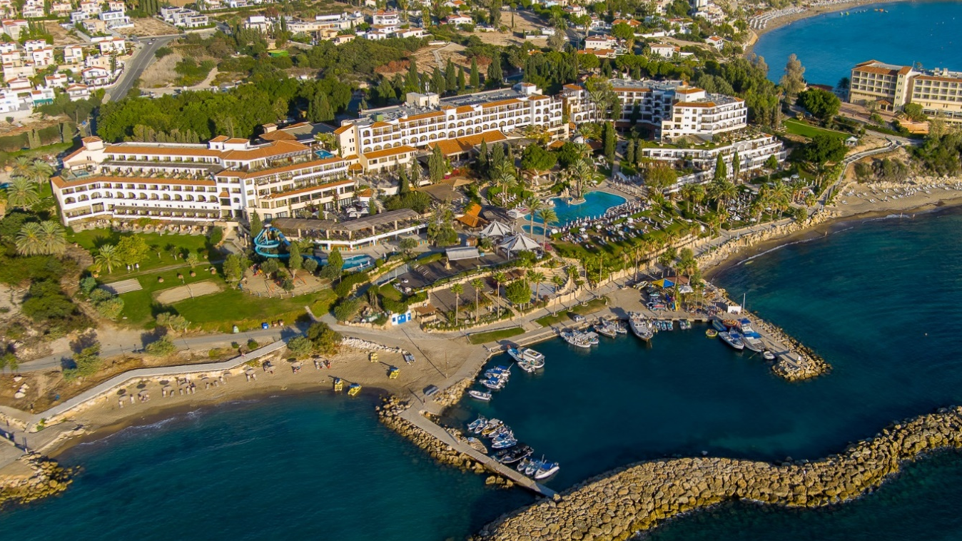
PAPHOSCYPRUS
28 – 30 APR
2025
Notes:
INTRO PAGE

Slide 2
DEAR SPEAKERS,
PLEASE FIND HERE TIPS TO CREATE A POWERPOINT PRESENTATION WITH THE CONFERENCE’S PATTERNS. WE DEVELOPED A TEMPLATE WITH THE MAINS TYPE OF SLIDES : HOME PAGE, OUTLINE, TRANSITION, TEXT, PICTURES, GRAPHICS, BOARD, ACKNOWLEDGEMENTS, ETC.
THIS POWERPOINT IS VERY SIMPLE TO USE. THE BACKGROUND WITH CONFERENCE’S PATTERNS ARE IN PLACE AND THE TEXT AREAS ARE ALL READY-TO-USE. YOU MUST ONLY WRITE OR COPY/PASTE YOUR CONTENTS IN THESE AREAS. ALL PAGES ARE NOT MANDATORY, YOU CAN DELETE SLIDES IF THEY ARE NOT USEFUL FOR YOUR PRESENTATION.
WE USE ONLY APTOS EXTRA BOLD FONT ALWAYS IN BLACK COLOR, IN CAPS FOR THE TITLE AND TINY FOR THE COURANT TEXT, ALWAYS IN BLACK COLOR.
LOOKING FORWARD TO SEEING YOU IN CYPRUS!

Slide 3
OUTLINE
PART 01 - TITLE
PART 02 - TITLE
PART 03 - TITLE
PART 04 - TITLE
PART 05 - TITLE
PART 06 - TITLE
Notes:
TRANSITION PAGE
TITLE SIZE 80
SUBTITLE 28

Slide 4
PART 01
TITLE
Notes:
TRANSITION PAGE
TITLE SIZE 80

Slide 5
PART 02
TITLE
Notes:
TRANSITION PAGE
TITLE SIZE 80

Slide 6
PART 03
TITLE
Notes:
TRANSITION PAGE
TITLE SIZE 80

Slide 7
PART 04
TITLE
Notes:
TRANSITION PAGE
TITLE SIZE 80

Slide 8
PART 05
TITLE
Notes:
TRANSITION PAGE
TITLE SIZE 80

Slide 9
PART 06
TITLE
Notes:
TRANSITION PAGE
TITLE SIZE 80

Slide 10
TITLE
SUBTILE
This is fake text. Please, write or copy/paste your text in this aera.
Pienite venes volentibus mod magni dolori ratam dipis alis alit quod quod quassinis aut voluptae verum esed moditae scienim olorendiciis atibus as estiatemodis as ipsam fugiati aeperia necate ped ut as doluptur? Elicimus ratem aut etus, ut rem as et, oditemod ut estis qui dolorero blaut aborios acestio. On num verum experum, incid erunt modios sit et aliquo int re nihilique idundi dis sam aperspe lluptatem doluptat.
Olende litam, simusci moluptatur resequatibus et andio que sum vellis apid ut aut es magni cum dolupta vid eri rehentotat as quiamustium sequae raectia cum eos aut audaerum utectiusdae verum experov iduciet at eaquat. Samendae antor aliquunt hil imenisimaio ime net alitatur aut ut qui omnisti ditem vel mos endelig nitio. Itas alignias quate odist et omnis suntur, alis aceratur alit adia ipsande llorpos senimpe arum licil mollit alicita tiusti aut occum es ad ut vent ipsande bissequosam etur?
Notes:
TEXT PAGE / PLEASE CHANGE ALL TEXT AREA WITH YOUR CONTENT
TITLE SIZE 80
SUBTITLE SIZE 28
TEXT SIZE 18

Slide 11
TITLE
SUBTILE
This is fake text. Please, write or copy/paste your text in this aera. Pienite venes volentibus mod magni dolori ratam dipis alis alit quod quod quassinis aut voluptae verum esed moditae scienim olorendiciis atibus as estiatemodis as ipsam fugiati aeperia necate ped ut as doluptur?
Notes:
PICTURES
SLIDE WITH 1 PICTURE
TITLE SIZE 80
SUBTITLE SIZE 28
TEXT SIZE 14

Slide 12
TITLE
This is fake text. Please, write or copy/paste your text in this aera. Pienite venes volentibus mod magni dolori ratam dipis alis alit quod quod quassinis aut voluptae verum esed moditae scienim olorendiciis atibus as estiatemodis as ipsam fugiati aeperia necate ped ut as doluptur?
SUBTILE
Notes:
PICTURES
SLIDE WITH 2 PICTURES
TITLE SIZE 80
SUBTITLE SIZE 28
TEXT SIZE 14

Slide 13
TITLE
This is fake text. Please, write or copy/paste your text in this aera. Pienite venes volentibus mod magni dolori ratam dipis alis alit quod quod quassinis aut voluptae verum esed moditae scienim olorendiciis atibus as estiatemodis as ipsam fugiati aeperia necate ped ut as doluptur?
SUBTILE
Notes:
PICTURES
SLIDE WITH 3 PICTURES
TITLE SIZE 80
SUBTITLE SIZE 28
TEXT SIZE 14

Slide 14
TITLE
SUBTILE
This is fake text. Please, write or copy/paste your text in this aera. Pienite venes volentibus mod magni dolori ratam dipis alis alit quod quod quassinis aut voluptae verum esed moditae scienim olorendiciis atibus as estiatemodis as ipsam fugiati aeperia necate ped ut as doluptur?
Notes:
SLIDE WITH 4 PICTURES
TITLE SIZE 80
SUBTITLE SIZE 28
TEXT SIZE 14

Slide 15
TITLE
This is fake text. Please, write or copy/paste your text in this aera. Pienite venes volentibus mod magni dolori ratam dipis alis alit quod quod quassinis aut voluptae verum esed moditae scienim olorendiciis atibus as estiatemodis as ipsam fugiati aeperia necate ped ut as doluptur?
SUBTILE
Notes:
PICTURES
SLIDE WITH 6 PICTURES
TITLE SIZE 80
SUBTITLE SIZE 28
TEXT SIZE 14

Slide 16
Notes:
PICTURES

Slide 17
Notes:
PICTURES

Slide 18
THANKS
PAPHOSCYPRUS
28 – 30 APR
2025
Text space for concluding sentence / thanks / information space for upcoming conferences / personalized message / …
Notes:
END PAGE

